Slide 1
Project: Arkime
NT534.N21.ATCL
GROUP 06
- MEMBERS:
+ LE PHAN HUU NGHIA – 20520650
+ NGO VO VIET KHOA – 17520642
+ NGUYEN DINH KHA – 20520562
+ BUI HUU KHANH - 18520897

Slide 2


Slide 3
Creator: Andy Wick / AOL / Verizon
Arkime (formerly Moloch) augments your current security infrastructure to store and index network traffic in standard PCAP format, providing fast, indexed access. An intuitive and simple web interface is provided for PCAP browsing, searching, and exporting.
Notes:
Arkime is an open-source solution that's scalable and offers the capability to capture and search packet data. Arkime enhances modern security infrastructure to enable storage and indexing, with network traffic in the standard PCAP format. The strength of Arkime lies in its ability to provide fast access, with a simple web interface used for browsing PCAPs, searching, and exporting files.

Slide 4

Large scale, open source, indexed packet capture and search
Available under Apache 2.0 open-source license
Available at https://arkime.com
Comprised of three components:
Capture: threaded C application
Viewer: Intuitive node.js application
Elasticsearch
Notes:
Arkime is a large-scale, open-source solution that provides the capability to capture and search packet data.
There are three components to Arkime:
- The capture component is used for collecting network traffic. It can capture live traffic, from the network or it can process PCAP files.
Viewer: This is where we'll spend most of our time doing traffic analysis.
Elastic: is part of the Arkime setup.
Arkime uses Elasticsearch (or OpenSearch) as its metadata storage backend. Metadata retention is based on the scale of the Elasticsearch cluster.

Slide 5
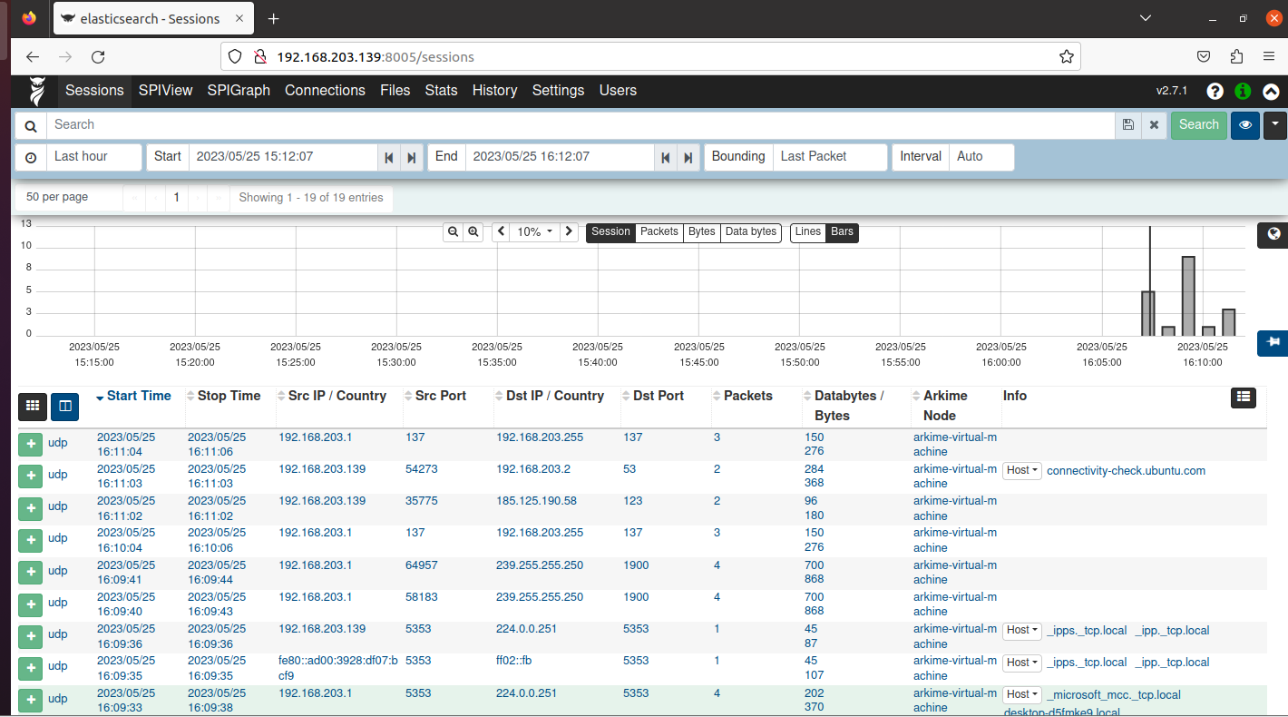

Slide 6
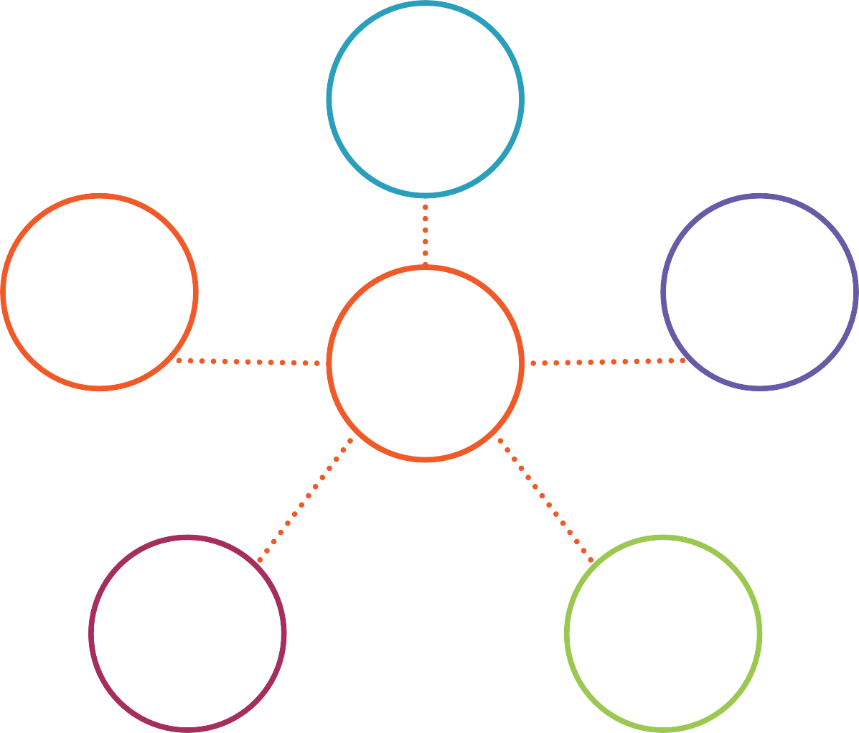
NIST Cybersecurity Framework
Identify
Recover
Protect
CSF
Respond
Detect
Notes:
This framework offers the capability to manage cybersecurity risks within businesses. At its core, it provides functions to achieve specific cybersecurity outcomes: Identify, Protect, Detect, Respond, Recover.

Slide 7
NIST Cybersecurity Framework
Anomalies and Events
CSF
Detect
Security Continuous Monitoring
Notes:
Each function can be broken down into categories and tightly linked with programming needs and specific activities to protect an organization.
Arkime assists an organization in filling gaps in the categories of “Anomalies and Events” and “Security Continuous Monitoring.”

Slide 8
NIST Cybersecurity Framework
DE.AE-2: Detected events are analyzed to understand attack
targets and methods
Anomalies and Events
DE.AE-3: Impact of events is determined
CSF
Detect
Security Continuous Monitoring
DE.CM-1: The network is monitored to detect potential cybersecurity events
Notes:
Arkime then helps ensure that detected events are analyzed to understand the objectives and methods of attack, the impact of events is determined during analysis, and the network is monitored to detect potential cybersecurity events.

Slide 9
MITRE ATT&CK
Network Analysis
OS Analysis
Application Analysis Infrastructure Analysis File Analysis
Threat Intelligence Incident Management
Data Analysis Type
Notes:
MITRE ATT&CK provides various attack techniques that adversaries may use against an organization.

Slide 10
MITRE ATT&CK
Network Analysis
OS Analysis
T1566:
Phishing
T1566.001:
Spearphishing Attachment
Application Analysis
Infrastructure Analysis File Analysis
Threat Intelligence
Incident Management
T1071:
Application Layer Protocol
Data Type
T1071.001:
Web Protocols
T1041:
Exfiltration Over C2 Channel
Notes:
Specifically, we will look at Network Analysis. While Arkime can provide the ability to view all our network traffic, the team will particularly focus on common attack techniques.
The first is Phishing, and more precisely, Spearphishing Attachment.
The team will also look at Application Layer Protocols, where attackers use common web protocols like HTTP as they communicate with commands and control.
Finally, we will examine Exfiltration Over C2 Channel

Slide 11
MITRE SHIELD
T1566:
Phishing
DTE0021 – Hunting: The process of searching for the presence of or information about an adversary.
T1071:
Application Layer Protocol
DTE0027 – Network Monitoring: The defender can implement network monitoring for and alert on anomalous traffic patterns, large or unexpected data transfers, and other activity that may reveal the presence of an adversary. (DUC0141)
T1041:
Exfiltration Over C2 Channel
DTE0028 – PCAP Collection: Collecting full packet capture of all network traffic allows you to review what happened over the connection and identify command and control traffic and/or exfiltration activity (DUC0170)
Notes:
MITRE SHIELD is a framework that helps us map different attack techniques and steps to protect our network. If we map attack techniques and tactics to MITRE SHIELD, we can consider categories such as:
DTE0021 – Hunting: The process of searching for the presence or information about the adversary.
DTE002 – Network monitoring in which the defender may conduct network monitoring to alert on unusual traffic patterns, large or unexpected data transfers, and other activities that could reveal the presence of an adversary. => Arkime is not used to create alerts, but allows investigation and network traffic analysis to identify these patterns. Arkime also has the capability to integrate with popular and open-source intrusion detection systems, so we can have alert information fed into our Arkime setup.
DTE0028 – PCAP Collection: This is one of the key capabilities Arkime offers, the ability to collect full packets of all network traffic. This allows us to review the history of what happened across our network to help recreate events,

Slide 12



















Security Suite
ISP
HR
EXEC
Globo-SW-01
Globo-R-01
Globo-SW-02
Finance
Datacenter
Globo-FW-01
Engineering
Notes:
So, where does Arkime fit into the standard enterprise setup? The actual deployment depends on where you want coverage. At its core, Arkime needs to monitor network traffic. Thus, any segment of our network that we want to provide the capability to capture full packets is where we should consider placing Arkime.

Slide 13




Elastic cluster PCAP storage
Arkime Viewer
ISP
Globo-SW-01
Globo-R-01
Globo-SW-02
Notes:
When an Arkime is deployed, it starts capturing entire packets and also sends data to Elasticsearch. What Arkime sends to Elasticsearch is traffic data, and this is the content we want to see in the viewer. This provides us the ability to search through our network traffic data. When we need to view data that isn't part of this data but also have the capability, through the viewer, to download that data for us or allow exporting pcap for further analysis.

Slide 14







Phishing with Attachments
Office Document
Additional Stages N
Post- infection
Macros
Malware
HTTP
request for payload
Notes:
A common attack scenario: Phishing with Attachments. A group of attackers attach office documents to an email and attempt to send it to a victim. These documents often contain macros, and while macros are a normal part of office documents, they are used to execute code. If the victim enables the content, it leads to the next stage (Additional Stages N). Powershell might be executed or used to download the next-stage payload, the malware runs and moves to the Infection stage. It's very common for HTTP to be used to request the executable file, and that executable file requests the payload to execute.

Slide 15
ARKIME DEMO
Network analysis with Arkime

Slide 16
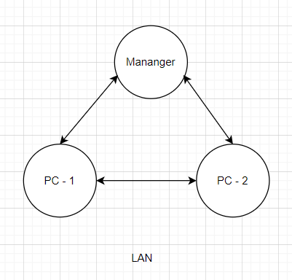
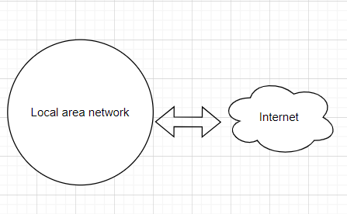
Demo 1
Demo 2, 3

Slide 17

What is Suricata ?
As a NG IDS/IPS
- Can handle high-speed network traffic and provides detailed analysis capabilities with powerful rules.
It can be integrated with other technologies

Slide 18

THANKS FOR WATHCHING !

